Slide 1

Feasibility Study
Roskilde Day-care
Made by Ilias, Thomas, Rasmus, Cristian, David

Slide 2
Operational feasibility
(Will the project support the business strategy of the company?)
Is the proposed system consistent with the IS strategy of the company?
The strategy is currently unknown. However, we believe it will benefit the company greatly by providing a standardised and centralised digital Administrative System. Currently, the day-care operates using MS Word, paper-based, and various other methods.
To which degree can the system solve business problems or take advantage of business opportunities?
A central System will minimise the 4 hours a day these tasks currently take.
How will the system influence the business processes and organizational structure?
It will greatly reduce the amount of time spent doing administrative tasks. It will provide up-to-date records of invoices and rostering, and will eliminate the need for paper printouts and mail by using email. It will clearly log payments and parental information, and who processed them.

Slide 3
Technical feasibility
(An analysis of the organization’s ability to develop the proposed system. For example: the project size, complexity, developers familiarity with the type of app, users familiarity with development process and domain area)
Can we do this project?
Yes, we have worked with similar, more complicated projects before.
Is the technology available to make it work?
Yes, we will be developing using only Java and IntelliJ
Is it possible to achieve the proposal within the performance criteria?
Yes, the criteria is quite straight-forward and can be achieved using a very simple program with low performance needs. It will run on almost any machine.
Are there sufficient skilled technologists available to staff the project?
Yes, we have been allocated five people with varying skillsets and knowledge levels, who have worked on similar projects in the past.

Slide 4
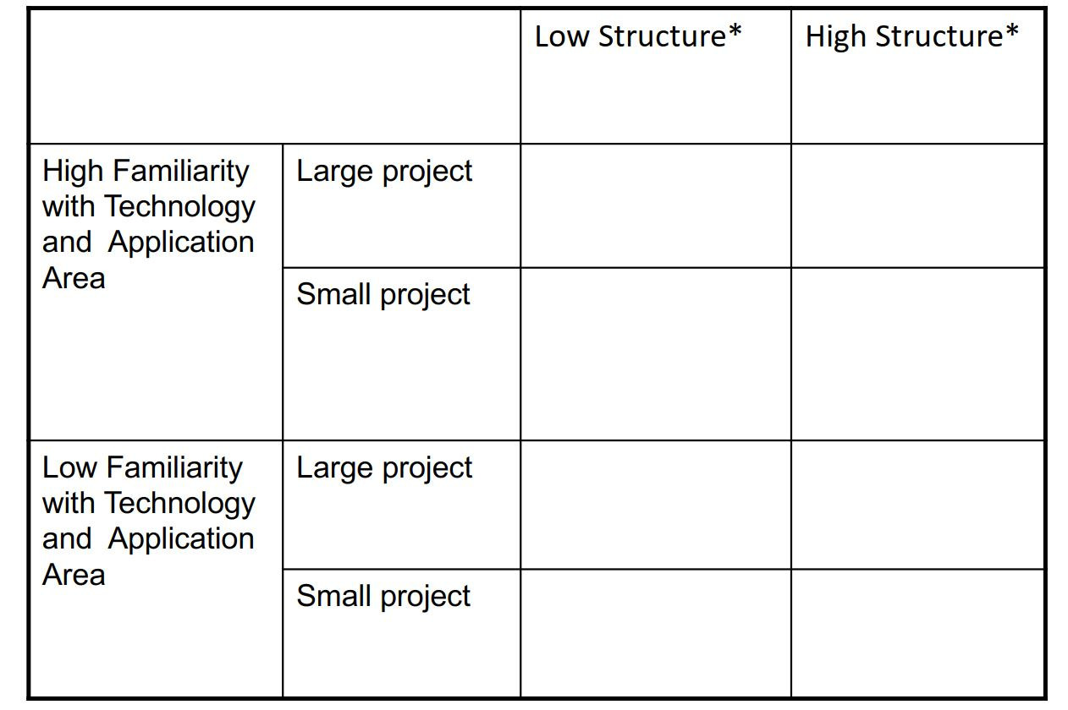
Risk Matrix – technical application

Slide 5
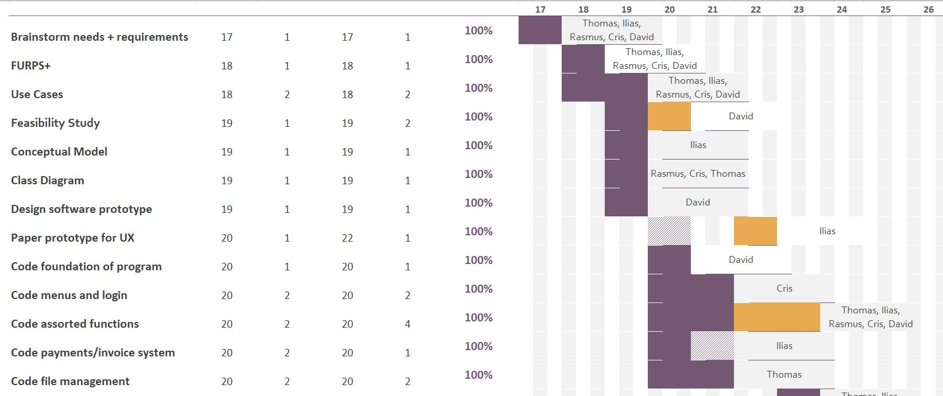
Schedule feasibility
(The likelihood that timeframes and deadlines can be kept)
Based on our Gantt chart draft the schedule was quite achievable.
*I forgot to take screenshots of the draft, so this is a screenshot of the completed chart.

Slide 6
Legal and contractual feasibility
(Which legal issues must be considered?)
Legal regulations
The System collects and stores sensitive information including CPR numbers, phone numbers and addresses, in line with regulations set by the Danish Data Protection Act (DDPA) and GDPR 2016/679. Key provisions are that the collected data is minimal to needs, accurate, secure and transparent.
Security of information, both physical and digital
We recommend that the System be installed on a computer with an auto-updating Firewall and Anti-virus. The System has minimal interaction with the internet, aside from sending emails out. We recommend a setup that allows no incoming traffic. We also advise the computer is kept password secured and in a locked environment.
System access and privileges
The System has tiered access for different users, and we recommend that passwords are kept individual and secure. All information on Parents and Children is able to be fully deleted at their request.
Accuracy and Transparency
Data is easily able to be updated to ensure ongoing accuracy. There is also the simple option of updating code in the future to allow the Admin to email all information they hold to a Parent at their request. Current data held is quite minimal and does not extend beyond names, addresses, phone numbers, emails etc.

Slide 7
Political and Economic feasibility
(How do key stakeholders within the organization view the proposed system?)
Roskilde Day-care is a private institution, administrated solely by Sandra Madsen. She is very positively involved in the project, as it will improve the quality of her work life greatly.
(Can we afford this project?)
How much will this project cost financially?
It is a two week project for five people, and will be charged accordingly. No extra fees (for example special training or equipment) are needed on top of that. See previous Gantt chart for specific breakdown.
Do the benefits equal or better the outlay?
Yes. We believe the System will halve the time spent on Administrative tasks, equalling 10 hours a week, or 520 hours a year. It will also increase the time Sandra is able to spend on ‘hands-on’ work inside the business.

Slide 8
Cost/benefits analysis
Cost | Benefits
Tangible (one time/recurring) Development/deployment costs. Employees off work for System training. New Policies/Procedures to be developed around data entry/retention relating to the new system. Intangible Parents unhappy with changes to how the Day-care stores and uses their information. | Tangible Estimated 2 hours per day saved on tasks. Accuracy and security of stored information. Updated and accessible rosters for staff. Easier invoicing for parents, direct to email. Intangible Sandra able to focus more on ‘hands-on’ tasks leading to increased customer interaction, growth of brand.

Slide 9

Verdict?
Feasible.

